Slide 1
Class Diagrams
Edited by R.A. Mustafa Büyükkeçeci from various UML resources.

Slide 2
Class Diagrams Overview
Definition: Class diagrams are the backbone of almost every object-oriented method including UML. It is a type of static structure diagram that describes the structure of a system by showing the system's classes, their attributes, operations (or methods), and the relationships among objects.
UML Diagram Type: Structural.

Slide 3
Recall: Static and Dynamic Model
UML diagrams represent two different views of a system model:
Static Model: Time independent view of the system.
E.g. Class has same number of students in an year.
Static model includes:
Class Diagram
Object Diagram
Component Diagram
Deployment Diagram
Dynamic Model: Time dependent view of the system.
E.g. ATM can accept card only when it is in ready state. ATM cannot read card when it is in error state. Thus state of ATM is a dynamic aspect.
Dynamic Modeling includes:
Sequence Diagram
Interaction Diagram
State Diagram

Slide 4
Class Diagrams Overview - 2
Class diagram is the most widely used diagram in modelling object-oriented system.
The class diagrams are widely used in the modelling of object oriented systems because they are the only UML diagrams which can be mapped directly with object oriented languages.
A class diagram is an important diagram in software development.
Class diagram is not only used for visualizing, describing and documenting different aspects of a system but also for constructing executable code (skeleton code) of the software application.
The class diagram shows a collection of classes, interfaces, associations, collaborations and constraints.

Slide 5
Class Diagrams Overview - 3
The UML diagrams like activity diagram, sequence diagram can only give the sequence flow of the application but class diagram is a bit different.
Class diagrams may specify both the conceptual (what) and implementation (how) details of the system.
So the purpose of the class diagram can be summarized as:
Analysis and design of the static view of an application,
Showing the collaboration among the elements of the static view,
Describing the functionalities performed by the system,
Construction of software applications using object oriented languages,
Base for “Component” and “Deployment” diagrams, and
Forward and reverse engineering.

Slide 6
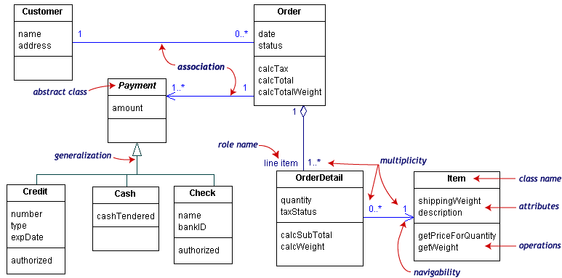
Class Diagram Overview - 4

Slide 7
Classes
A class is an element that defines the attributes and operations that an object is able to generate.
Graphically, a class is rendered as a rectangle, usually including its name, attributes, and operations in separate, designated compartments.
UML class notation is a rectangle divided into three parts: class name, attributes, and operations.
<Class Name> Compulsory
<Attributes> Optional
<Operations> Optional
Address Book
# name: String
+ getName(): String + setName(String): Void

Slide 8
Class Name
The name of the class is the only required tag in the graphical representation of a class.
It always appears in the top-most compartment.
Class names should be singular, discrete, countable nouns (plurals and proper nouns should be avoided) mostly written in italics.
A class’ name establishes a type for the objects that will be instantiated based on it.
E.g. the “Blog Account” class defines the information that the system will hold relating to each of the user’s accounts.
Thus, choose simple but descriptive names.

Slide 9
Class Attributes
An attribute is a named property of a class that describes the object being modeled (variables owned by the class itself).
The attribute section of a class (the middle compartment) lists each of the class's attributes on a separate line.
The attribute section is optional, but when used it contains each attribute of the class displayed in a list format.
Please note that there are analysis (domain) type class diagrams which has no internal structure except the class name.

Slide 10
Class Attributes - 2
An attribute’s name can be any set of characters, but no two attributes in the same class can have the same name.
Attribute name is generally a short noun or a noun phrase written in lower case and aligned to left.
Attribute declaration may include visibility, type and initial value.

Slide 11
Class Operations
A class’ operations represents the actions or functions that a class can perform.
The class's operations are documented in the third (lowest) compartment of the class diagram's rectangle, which again is optional.
Like the attributes, the operations of a class are displayed in a list format, with each operation on its own line.

Slide 12
Class Operations - 2
Operation name is generally a short verb (name Operations with a strong verb – irregular verbs) or a verb phrase written in lower case and aligned to left.
A class’ operations may include visibility, operation parameter list and type of value returned.

Slide 13
Attribute and Operation Visibility
Attributes and operations can be assigned a level of visibility shown on the class diagram with a visibility indicator.
The visibility of a feature can be defined by either a keyword or a symbol and must be placed before the member's (any attribute or method) name.
There are four specific types of visibility:
Type | Symbol | Definition
Private | - | A/O is available only to the current class.
Public | + | A/O is available to the current and other classes.
Protected | # | A/O is available to the current and inherited classes.
Package | ~ | A/O is available only to the other classes within the same package.

Slide 14
Class Relationship Types
Class diagrams have various relationship types however mostly four basic relationship types is used, which are:
Association
Aggregation
Composition
Generalization (Inheritance)

Slide 15
Association
Association represents a relationship between multiple classes or a class and itself (self, reflexive association).
Associations are labelled using a verb phrase or a role name, whichever better represents the relationship.
Association contains multiplicity symbols (will be mentioned later), which represent the minimum and maximum times a class instance can be associated with the related class instance.
There are three different types of association:
Self (reflexive) Association
Bidirectional Association
Undirectional Association

Slide 16
Reflexive Association
Association Label
manager
1
manages
Employee
0..*
Multiplicity
Given relationship means that a member of employee can be the manager of another employee. However, an employee might not have any other employees to manage.
When a class is associated to itself, this does not mean that a class's instance is related to itself, but that an instance of the class is related to another instance of the class.

Slide 17
Bidirectional Association
Associations are always assumed to be bidirectional by default; this means that both classes are aware of each other and their relationship, unless you qualify the association as some other type.
A bidirectional association is indicated by a solid line between the two classes.
At either end of the line, you place a role name and a multiplicity value.

Slide 18
Unidirectional Association
In a unidirectional association, two classes are related, but only one class knows that the relationship exists.
A unidirectional association is drawn as a solid line with an open arrowhead (not the closed arrowhead, or triangle, used to indicate inheritance) pointing to the known class.
Like standard associations, the unidirectional association includes a role name and a multiplicity value, but unlike the standard bi-directional association, the unidirectional association only contains the role name and multiplicity value for the known class.

Slide 19
Bi and Unidirectional Associations
Bidirectional
0..*
Assigned
Flight
Plane
Assigned
0..*
1
Lives At
Student
Address
1
Unidirectional

Slide 20
Aggregation
Aggregation is a special form of an association.
Aggregations are used to depict elements which are made up of smaller components.
Aggregation relationships are shown by a white (unfilled) diamond-shaped arrowhead pointing towards the target or parent class.
The aggregations “has-a” relationship is of “weak-type”.

Slide 21
Composition
A stronger form of aggregation - a composite aggregation (or composition) - is shown by a black diamond-shaped arrowhead and is used where components can be included in a maximum of one composition at a time.
If the parent of a composite aggregation is deleted, usually all of its parts are deleted with it; however a part can be individually removed from a composition without having to delete the entire composition.
Compositions are transitive, asymmetric relationships and can be recursive.
The aggregations “is-a” relationship is of “strong-type”.

Slide 22
Aggregation and Composition Example
Aggregation
Cars may have passengers.
Car
Car
Composition
Every car has an engine.
Passengers
Engine
Aggregation implies a relationship where the child can exist independently of the parent.
Composition implies a relationship where the child cannot exist independent of the parent.

Slide 23
Generalization
A generalization is used to indicate inheritance.
It represents a relation between a parent (a more abstract class) and a child (a more specific class).
Generalization is drawn from the specific classifier to a general classifier, the generalize implication is that the source inherits the target's characteristics.
Generally referred to as a “is-a-kind-of” relationship.
Child objects may be used instead of parent objects since they share attributes and operations; the opposite is not true.

Slide 24
Recall: Inheritance & Polymorphism
Inheritance is when a class derives from an existing class.
So if you have an “animal” class, then you have a “cat” class that extends “animal”, “cat” inherits all the things that “animal” has.
Polymorphism (in the OOP sense, other paradigms use the word to mean other things) means a function behaves differently based on the kind of object it's operating on.
Suppose you have an “animal” class, which has a “speak” method, and “cat” and “dog” subclasses. When you call “speak” method it will do completely different things based on what kind of animal you have. Dog class will bark and cat class will meow.

Slide 25
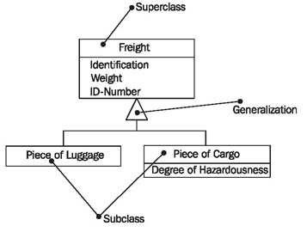
Generalization Example

Slide 26
Multiplicity
In class diagrams, multiplicity (which is optional) indicates how many objects of a class may relate to the other classes in an association.
A multiplicity specification is a subset of the open set of non-negative integers (single numbers or ranges of numbers).
To determine the multiplicity of a class, ask yourself how many objects may relate to a single object of the class.
The answer determines the multiplicity on the other end of the association.
Indicator | Meaning
0..1 | Zero or one
1 | One only
0..* | Zero or more
1..* | One or more
* | Zero or more
n | Only n (where n > 1)
0..n | Zero to n (where n > 1)
1..n | One to n (where n > 1)

Slide 27
Multiplicity Example
Multiplicities, classes and relationship types depends on the scenario. Therefore, try to understand the basic concept.
Body
1
forms
has
1
installed to
drives
1
1
Driver
Car
Engine
*
has
has
1
1
has
Travel in
0..7
Passengers

Slide 28
More Relation and Class Types
NARY Association
Dependency
Realization
Interface
Enumeration

Slide 29
NARY Association
An NARY association relates three or more classes.
For example, in the project management system, the use of a worker involves the worker, her units of work, and her associated work products.
In a UML class diagram, an NARY association is shown as a large diamond with solid-line paths from the diamond to each class.
An NARY association may be labelled with a name.
An NARY association is commonly named using a verb phrase.
For an NARY association, any one instance of the association could relate any combination of the associated classes that is permitted by each classes multiplicity.

Slide 30
NARY Association
Multiplicities may vary according to the scenario.
Class 2
*
Relation
Name
Class 1
Class 3
*
*

Slide 31
Dependency
Dependency is often confused as association.
A dependency specifies that one model element requires the presence of another model element in order to function or be implemented.
The implication of the dependency is that, if the model element upon which the dependency is specified is changed, then the dependent model element may also need to be changed.
In other words, dependency indicates that a change to one model element can affect another model element.

Slide 32
Dependency -2
Dependencies fall into four main categories: binding, abstraction, usage and permission (we are not going to talk about them).
Dependency is represented by a dashed arrow starting from the dependent class to its dependency.
E.g. relationship between a “Sale” class and a “Product” class can be set using dependency association.
Typically, dependency relationships do not have names and multiplicity.
Dependency is typically read as “uses a” as in “sale class uses a product class”.
Sale
Product

Slide 33
Realization
A realization relationship indicates that a class implements, or realizes (implements or executes) an interface at the other end.
A realization from a source element (called the realization element) to a target element (called the specification element) indicates that:
the source element supports at least all the operations of the target element,
without necessarily having to support any attributes or associations of the target element.
Realizations can only be shown on class, package or component diagrams.
Realizations are represented by dashed line with a plain arrow head.

Slide 34
Interface
An interface is a kind of classifier that define a set of related public operations (operations that have public visibility) and responsibilities.
In other words, interface specifies how objects communicate with each other.
An interface specifies a contract.
Any instance of a classifier that realizes (implements) the interface must fulfil that contract and thus provides services described by contract.
An interface may be shown using a rectangle symbol with the keyword «interface» preceding the name.

Slide 35
Realization and Interface
<<interface>> Mammals
<<Attributes>>
<<Operations>> +walk ()
Target or
“specification element”
Source or “realization element”
Realization
Cats
<<Attributes>>
<<Operations>> +walk () (Operation refined form “Mammals”)
Dogs
<<Attributes>>
<<Operations>> +walk () (Operation refined form “Mammals”)

Slide 36
Enumeration
It is sometimes useful to be able to specify a limited and predefined set of values from which the value of a particular attribute can be set.
The basic notation for an enumeration is a named class symbol.
The inclusion of the <<enumeration>> stereotype above the class name indicates that this class represents an enumeration of values.
The literal values for the enumeration are placed in the middle list compartment of the class symbol.

Slide 37
Enumeration Example
<<enumeration>> Days_of_The_Week
Sunday Monday Tuesday Wednesday Thursday Friday Saturday

Slide 38
How to Draw Class Diagram?
The following points should be remembered while drawing a class diagram:
The name of the class diagram should be meaningful to describe the aspect of the system.
Each element and their relationships should be identified in advance.
Responsibility (attributes and methods) of each class should be clearly identified.
For each class minimum number of properties should be specified. Because unnecessary properties will make the diagram complicated.
Use notes when ever required to describe some aspect of the diagram. Because at the end of the drawing it should be understandable to the developer/coder.
Finally, before making the final version, the diagram should be drawn on plain paper and rework as many times as possible to make it correct.

Slide 39
Summary
 | Symbol
This class is associated (bidirectional) with |  | this class.
This class is associated (unidirectional) with |  | this class.
This class is dependent upon |  | this class.
This class inherits from |  | this class.
This class has |  | this interface.
This class is a realization of |  | this class.
These classes compose without belonging to |  | this class.
These classes compose and are contained by |  | this class.

Slide 40
Summary - 2
Passengers
Passengers
Passengers
0..*
Airline Staff
0..*
0..*
Airplane
Airplane
Airplane
Association
Directed Association
Reflexive Association
Multiplicity
Library
Library
Fixed Account
Printer
1..*
Books
Books
Bank Account
Printer Setup
Aggregation
Composition
Inheritance
Realization

Slide 41
Analysis and Design Class Diagrams
There are different kinds of models in software engineering: analysis and design models, structural, interaction and behavioral models, etc.
Roughly speaking,
Analysis designates some kind of understanding of a problem or situation.
Design is related to the creation of a solution for the analyzed problem.
Model is some kind of simplification that is used to better understand the problem (analysis model) or the solution (design model).

Slide 42
Analysis and Design Class Diagrams - 2
There are two types of class diagrams:
Analysis (Domain) Class Diagram: models the concepts (conceptual model) in the problem space.
Typically a domain class diagram shows the name of the classes, the relationships between classes and helps model the vocabulary of the problem space.
The domain class diagram models the high level concepts in the system.
Design Class Diagram: helps to model the actual design concepts.
Obviously a design class diagram has more detail than the domain diagram, because it must model the fine-grained concepts of implementation.
The design class diagram models the low level concepts in the system.

Slide 43
Analysis and Design Class Diagrams - 3
In UML diagrams which represent analysis (domain) model, you cannot use special relationship types.
All classes are interlinked with a line, which signifies relation, and you should use text annotations over the lines to illustrate what relation it exactly is.
While in design models, you have to use all necessary relationship types like association, inheritance, etc. and specify the type of properties and methods, etc.

Slide 44
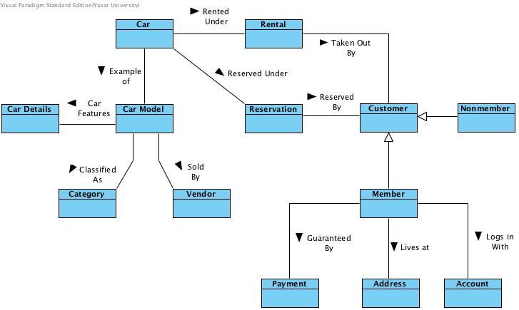
An Analysis Type Class Diagram Example

Slide 45
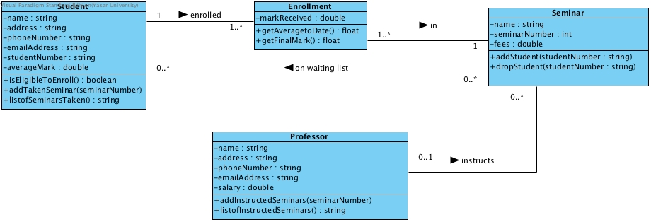
A Design Type Class Diagram Example

